Slide 1

Neural Networks

Slide 2
Inspiration
Neural networks are a biologically-inspired algorithm that attempt to mimic the functions of neurons in the brain.
Each neuron acts as a computational unit, accepting input from the dendrites and outputting signal through the axon terminals.
Actions are triggered when a specific combination of neurons are activated.

Slide 3
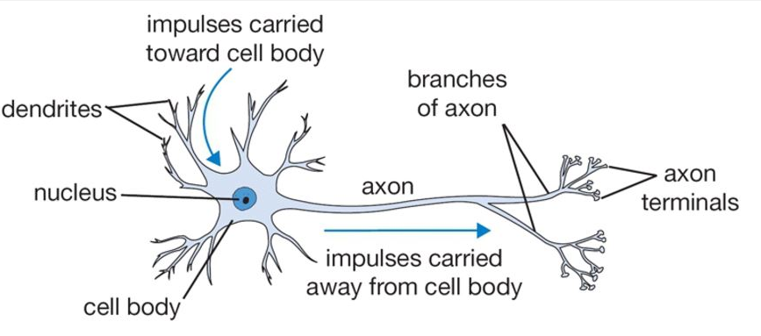
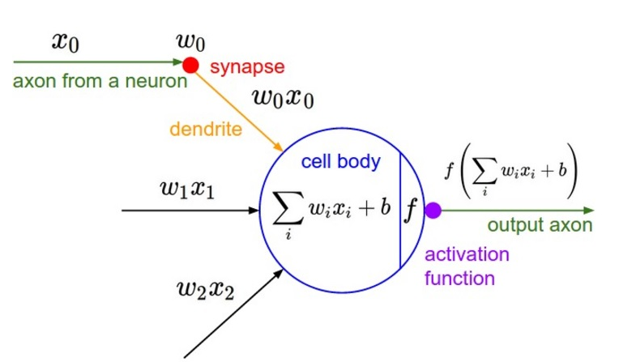

Slide 4
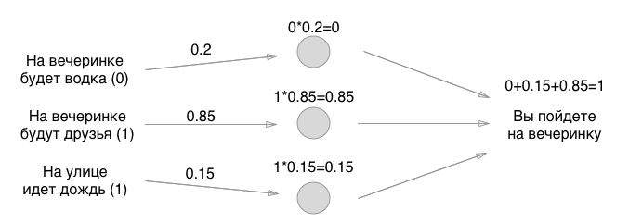
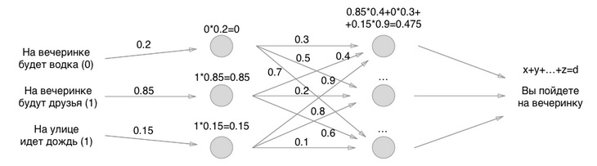
Examples from web

Slide 5
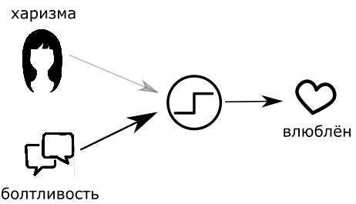
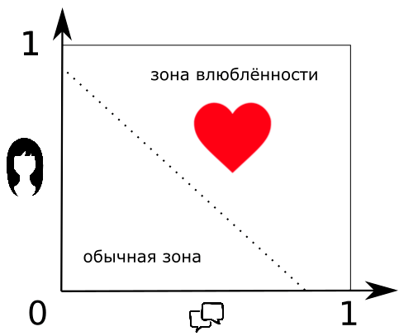
Examples from web

Slide 6
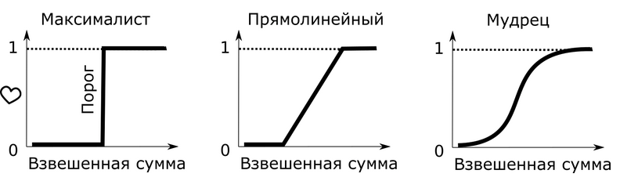
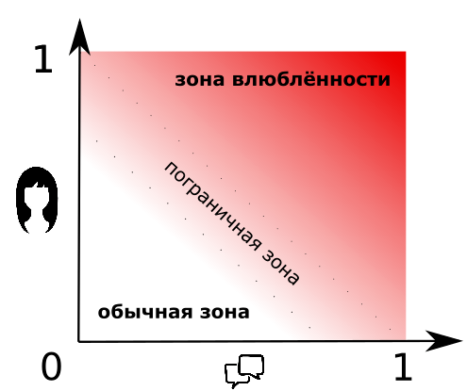
Examples from the web

Slide 7
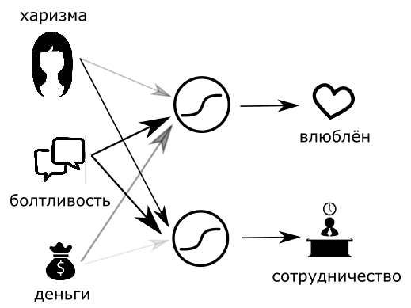
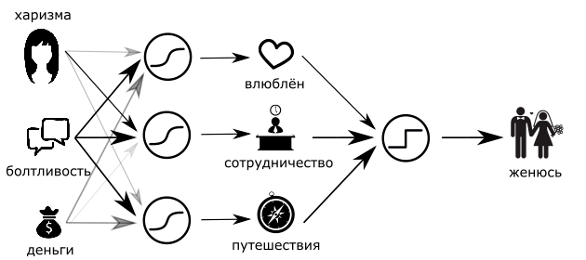
Examples from the web

Slide 8
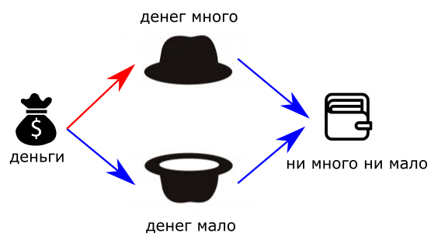
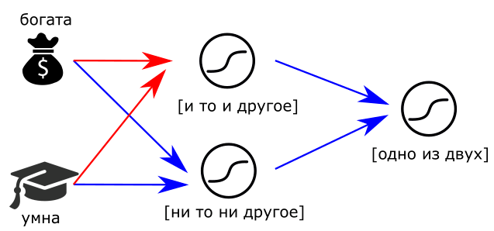
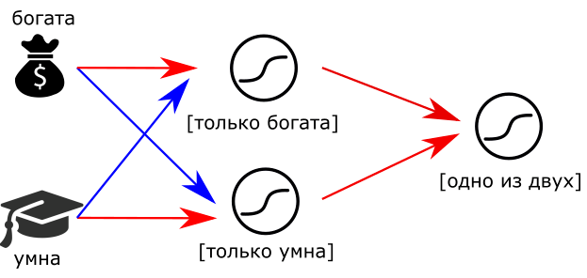
Examples from the web

Slide 9
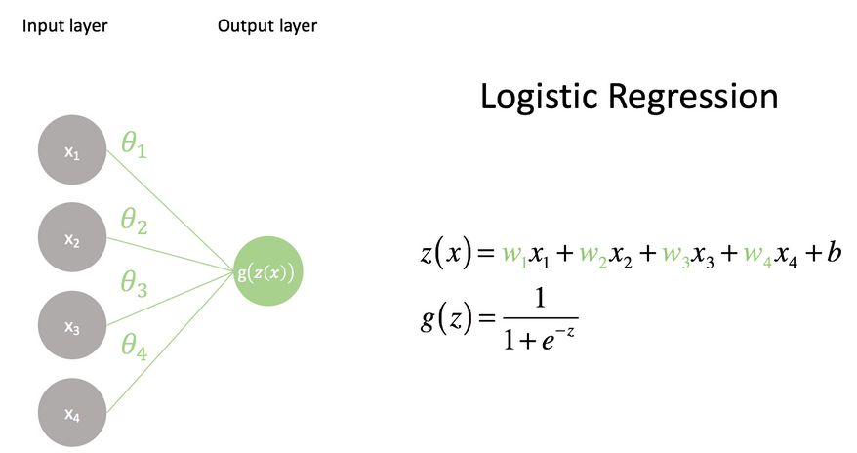
A computational model of a neuron
When we pass the linear combination of inputs through the logistic (also known as sigmoid) function, the neural network community refers to this as activation.

Slide 10
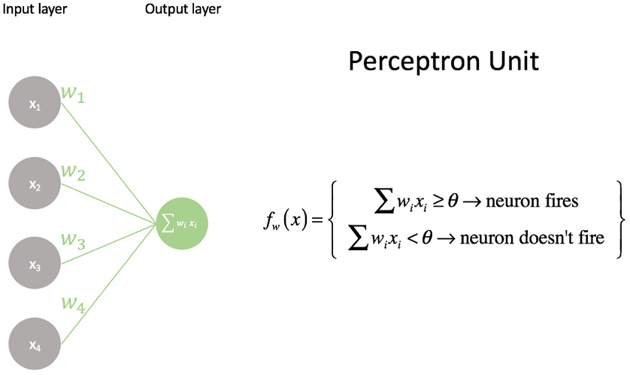
Comparison to a perceptron unit
The perceptron is the simplest neural unit that we can build.
It takes a series of inputs, xi, combined with a series of weights, wi, which are compared against a threshold value, θ.
If the linear combination of inputs and weights is higher than the threshold, the neuron fires;
If the combination is less than the threshold it doesn't fire.

Slide 11
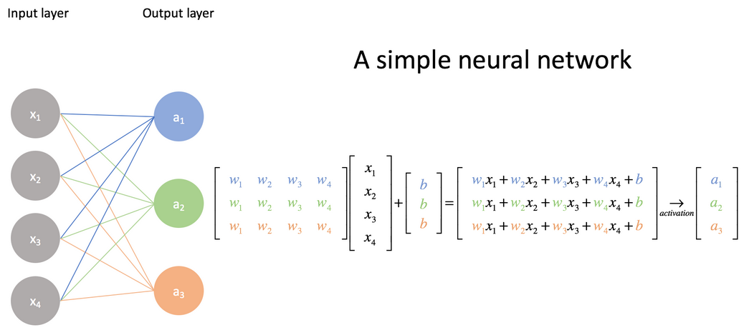
Building a network of neurons

Slide 12
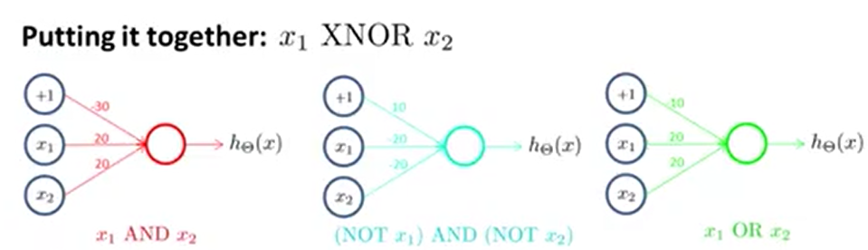
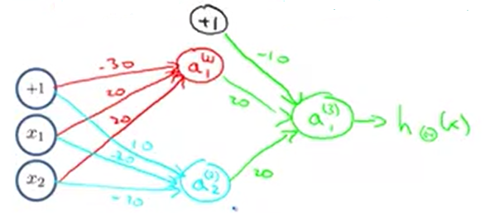
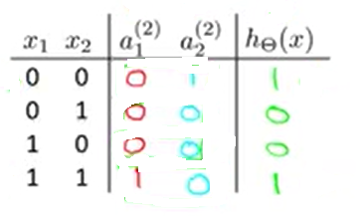

Slide 13
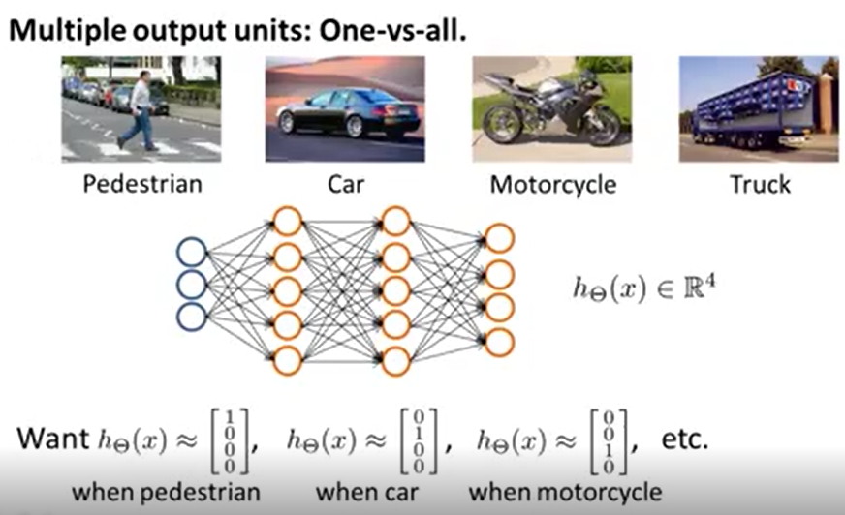

Slide 14
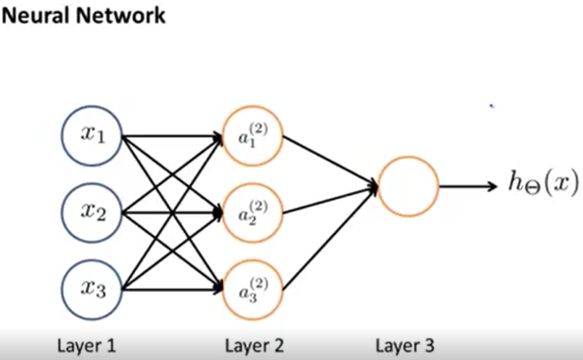
Input layer
Hidden layer
Output layer

Slide 15
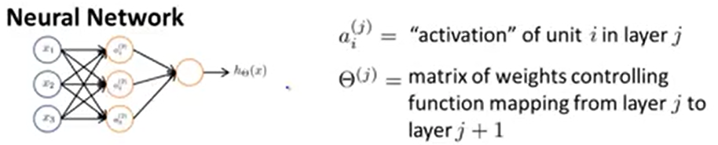
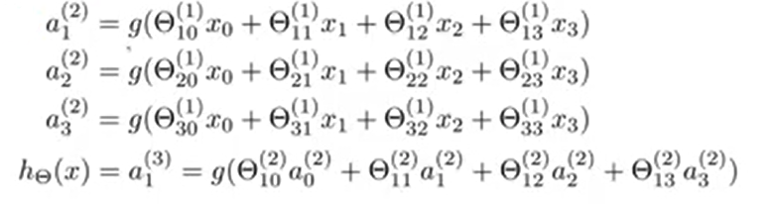

Slide 16
Learning in Multilayer Neural Networks
Learning consists of searching through the space of all possible matrices of weight values for a combination of weights that satisfies a database of positive and negative examples (multi-class as well as regression problems are possible).
Note that a Neural Network model with a set of adjustable weights defines a restricted hypothesis space corresponding to a family of functions.
The size of this hypothesis space can be increased or decreased by increasing or decreasing the number of hidden units present in the network.

Slide 17
Appropriate Problems for Neural Network Learning
Instances are represented by many attribute-value pairs (e.g., the pixels of a picture. ALVINN [Mitchell, p. 84]).
The target function output may be discrete-valued, real-valued, or a vector of several real- or discrete-valued attributes.
The training examples may contain errors.
Long training times are acceptable.
Fast evaluation of the learned target function may be required.
The ability for humans to understand the learned target function is not important.

Slide 18
History of Neural Networks
1943: McCulloch and Pitts proposed a model of a neuron --> Perceptron (read [Mitchell, section 4.4 ])
1960s: Widrow and Hoff explored Perceptron networks (which they called “Adelines”) and the delta rule.
1962: Rosenblatt proved the convergence of the perceptron training rule.
1969: Minsky and Papert showed that the Perceptron cannot deal with nonlinearly-separable data sets---even those that represent simple function such as X-OR.
1970-1985: Very little research on Neural Nets
1986: Invention of Backpropagation [Rumelhart and McClelland, but also Parker and earlier on: Werbos] which can learn from nonlinearly-separable data sets.
Since 1985: A lot of research in Neural Nets!

Slide 19
k-NN algorithm
The definition of k-nearest neighbors is trivial:
Suppose that each esperience can be represented as a point in an space For a particular point in question, find the k points in the population that are nearest to the point in question. The class of the majority of the of these neighbors is the class to the selected point.

Slide 20
k-NN algorithm
c
c1
c3
₁
c4
c4
c1
c₂
c2
New input
c4
c3
c2
Inputs already classified
Class 1

Slide 21
k-NN algorithm
Finding the k-nearest neighbors reliably and efficiently can be difficult. Other metrics that the Euclidean can be used.
The implicit assumption in using any k-nearest neighbors technique is that items with similar attributes tend to cluster together.

Slide 22
k-NN algorithm
The k-nearest neighbors method is most frequently used to tentatively classify points when firm class bounds are not established.
The learning is done using only positive examples not negative.

Slide 23
References
https://skymind.ai/wiki/neural-network
https://medium.com/cracking-the-data-science-interview/a-gentle-introduction-to-neural-networks-for-machine-learning-d5f3f8987786

